Slide 1
Welcome to Hendrick Parent Information Night 2019-2020 6th Grade Students

Slide 2
HMS Administration Team
Lisa Long Principal
Adrienne Hunter Assistant Principal
Mark Wilczynski Assistant Principal

Slide 3
Hendrick Middle School Counselors 2019 – 2020
Denise Menard 6th grade
Victoria Neal Hines 7th grade
Sally Villani 8th grade

Slide 4
Classes are assigned randomly by the computer system to systemically balance sections.
This also allows students the opportunity to meet new people and make new friends.

Slide 5
REQUIRED CORE COURSES
LANGUAGE ARTS - 2 hour block
(English & Reading with the same teacher)
MATH
SCIENCE
SOCIAL STUDIES
PHYSICAL EDUCATION
FINE ARTS (Band, Choir, or Orchestra)

Slide 6
HONORS CLASSES
Classes which are at an accelerated pace.
Must qualify for Honors classes
6th Grade Honors Math 6th Social Studies PACE

Slide 7
Fine Arts:
Select ONE of the fine art subjects you would like to take in sixth grade. If you choose Orchestra, please put a “1” and a “2” by your top 2 preferences for instruments. If you choose Band, you will make your instrument selection later this semester.
______ Orchestra ______ Band ______Choir
_____ Violin Flute Trumpet _____ Male Voice
_____ Viola Oboe French Horn _____ Female Voice
_____ Cello Clarinet Trombone
_____ Bass Bassoon Euphonium
Saxophone Tuba
Percussion

Slide 8
Fine Arts Department Choir, Band and Orchestra
Dennis Langevin – Orchestra
Kelton Burnside – Orchestra
Christopher Clark – Band
Carter Walsh – Band
Terri Hamilton – Choir
Alexis Wright – Choir

Slide 9
Fine Arts Department Choir, Band and Orchestra
Orchestra interviews will be held at Hendrick
Saturday, March 30, 2019
Band interviews will be held at Hendrick
Saturday, April 13, 2019
Choir does not require an interview.
Your interview time will be mailed or emailed to you by the band or orchestra department prior to the interview date.

Slide 10
SAMPLE SCHEDULE
1ST Semester 2ND Semester
1ST MATH | 1ST MATH
2ND MUSIC | 2ND MUSIC
3rd LANGUAGE ARTS | 3RD LANGUAGE ARTS
4TH LANGUAGE ARTS LUNCH | 4TH LANGUAGE ARTS LUNCH
5TH HAWK Time | 5TH HAWK Time
6TH P.E. | 6TH P.E.
7TH SCIENCE | 7TH SCIENCE
8TH SOCIAL STUDIES | 8TH SOCIAL STUDIES

Slide 11
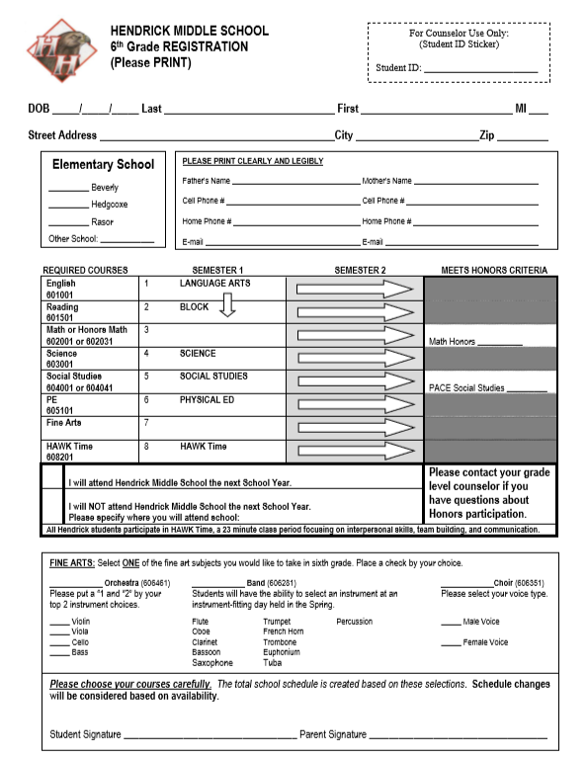

Slide 12
REGISTRATION CARD
SEMESTER 1
SEMESTER 2
LANGUAGE ARTS
English | 1
Reading | 2
Math | 3 |  | Math Honors ____________
Science | 4
Soc Studies | 5 |  | PACE Social Studies ________________
PE/Athletics | 6
Fine Arts* | 7
HAWK Time | 8 HAWK Time
 | I will attend Hendrick Middle School for the 2018 – 2019 school year.
 | I will NOT attend Hendrick Middle School for the 2018 – 2019 school year. Please specify where you will attend school:
BLOCK
SCIENCE
SOCIAL STUDIES
PHYSICAL ED

Slide 13
REGISTRATION CARD
Registration cards are due back to your elementary teacher or counselor by Thursday, January 24, 2019.

Slide 14
GENERAL INFORMATION
Tutorials are a positive means to keep up with the curriculum and help students succeed.
Monitor your student’s grades via parent portal at https://parentviewer.pisd.edu
Teacher e-mail addresses and phone numbers will be sent home when school starts.

Slide 15
LOCKERS
EVERY STUDENT WILL BE ASSIGNED A COMBINATION LOCKER
DON’T WORRY…YOU’LL HAVE TIME TO PRACTICE USING YOUR COMBINATION LOCK DURING SCHEDULE PICKUP IN AUGUST
BACKPACKS REMAIN IN YOUR LOCKER
YOU DON’T HAVE TO CARRY EVERYTHING WITH YOU TO EACH CLASS

Slide 16
How long do I have to get to each class?
You have 4 Minutes between classes.
All of the Math, Language Arts Block, and Social Studies classes are in the same area.
Science classrooms are upstairs.
The gym and music areas are on the 1st floor.
YOU CAN DO IT!

Slide 17
LUNCH
We have 3 lunch periods at Hendrick MS.
A , B , and C lunch occur during 4th period.
Each lunch lasts about 30 minutes.
6th grade eats during “B” lunch.
Usually starts around 11:30 a.m.
6th grade students will be assigned to lunch tables according to their 4th period class.

Slide 18
DISMISSAL TIME
1. Walk
2. Parent pickup
3. Bike
4. Bus
We will have adults outside directing students to the appropriate bus.

Slide 19
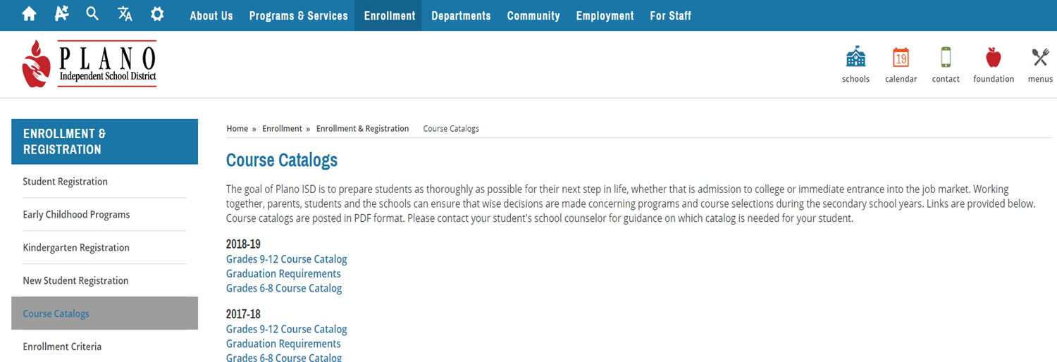
A COURSE GUIDE IS AVAILABLE AT:
https://www.pisd.edu/coursecatalogs

Slide 20
Thank you for coming tonight!
We will be available to answer questions following the meeting.
You may also call or email:
469-752-5618
denise.menard@pisd.edu

